Slide 1
Parson Programming Puzzles and Pilot Field Study
Emily Li, Juvaria Shahid, Rebecca Cawkwell, Sandy Zhao,

Slide 2
Outline
Motivation
Related Work
Project Planning
Implementation
Demos
Future Work

Slide 3
Gain Feedback
Motivation
Related Work
Project Planning
Implementation
Demo
Future Work
Gain feedback from teachers on study design
Effective puzzles, instructions & tests
Ideas for distractors - what do students get confused by
How long an activity might take
Create connections with teachers to potentially hold the study
Create connections with other teachers

Slide 4
Student Testing of the System
Motivation
Related Work
Project Planning
Implementation
Demo
Future Work
To learn about the effectiveness of SAGE
To test the three different learning conditions
Parson Puzzle
Parson Puzzle with Distractors
Scratch (no parson palette or feedback)

Slide 5
Distractors in Field Studies
Motivation
Related Work
Project Planning
Implementation
Demo
Future Work
Distractors in Parson Puzzles Decrease Learning Efficiency for Young Novice Programmers
Distractor types: Extra noise, Familiar suboptimal paths, Incomplete suboptimal paths → Only one possible solution
Their Finding: Distractors did not increase their "transfer task performance"

Slide 6
Field Study Preparation
Motivation
Related Work
Project Planning
Implementation
Demo
Future Work
Contacted teachers from the Upperline School of Code (summer SWE boot camp in NYC - 20-30 teachers)
Initially build upon pre/post tests and tutorial made by Ben and Jady
Eventually made our tests from scratch
Our focus shifted from loops to sequences
Gained insight on the types of questions more suitable for students

Slide 7
Puzzle Building
Motivation
Related Work
Project Planning
Implementation
Demo
Future Work
Leverage our own knowledge from learning + teaching computer science
Rely on teacher feedback we gained through the semester for both content and distractors
Originally created loop puzzles and transitioned to sequences due to the students participating

Slide 8
Document Summary
Motivation
Related Work
Project Planning
Implementation
Demo
Future Work
Document | System | Notes
Background Survey | Qualtrics | Remove identifying questions
Pre and Post Test | Qualtrics | Isomorphic, 10 total (7:sequences, 3:loops)
Cognitive Load Surveys | Qualtrics | Rewording for student comprehension
Teacher User Guide | GDocs | Detailed schedule of the 3 days
Student Instructions (3 versions) | GDocs | Must include attributes, Brief user guide
SAGE Tutorial | GSlides | Updated style, images and points
SAGE Study Puzzles | SAGE | “Your first recipes!”, 3 Quests with 4 Puzzles

Slide 9
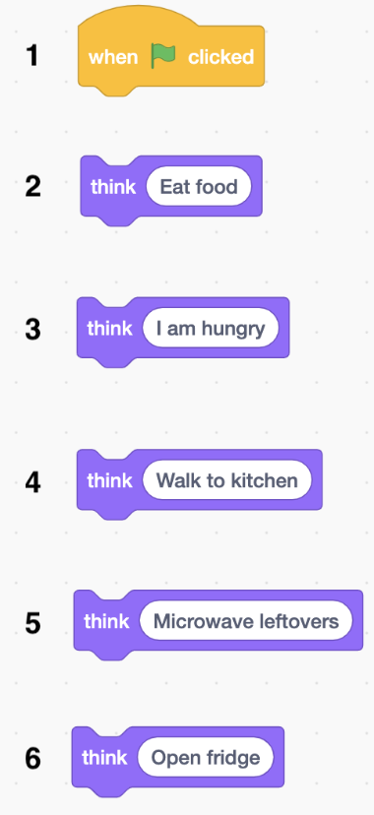
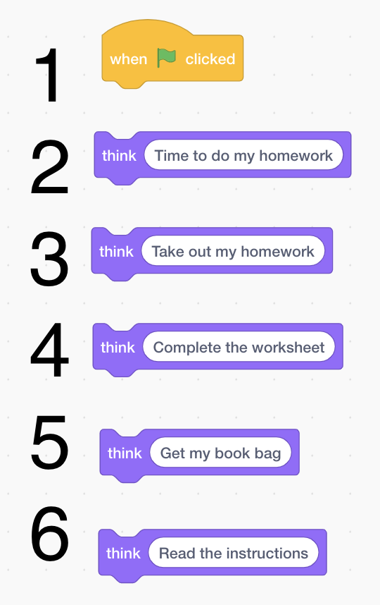
Isomorphic Pre and Post Tests: Sample questions
Motivation
Related Work
Project Planning
Implementation
Demo
Future Work
Notes:
Isomorphic
No variables involved because variables are harder to understand than sequences

Slide 10
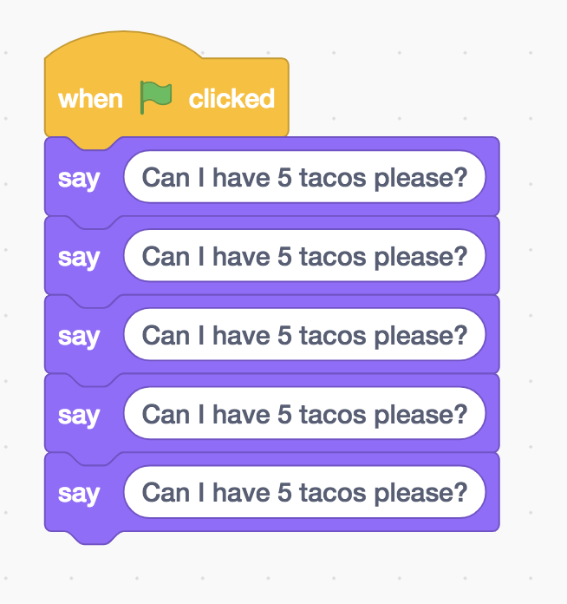
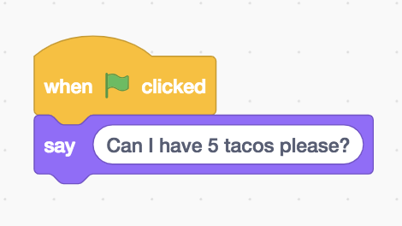
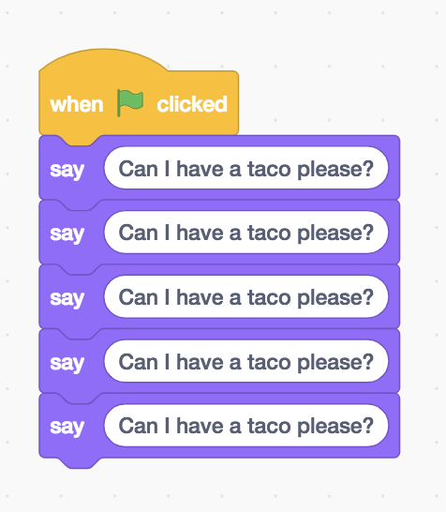
Sample Question Pre and Post Tests
Motivation
Related Work
Project Planning
Implementation
Demo
Future Work
You are ordering taco in the restaurant. For some reason, you can only get one taco at a time. However, you want 5 tacos in total. Thus, if you want 5 tacos, which of the following sequence would you choose?
Notes:
Isomorphic
Pre-test link:
Post_test link:

Slide 11
Question Types Pre and Post Tests
Motivation
Related Work
Project Planning
Implementation
Demo
Future Work
7 on sequences with varied difficulty:
Placing blocks in order
Choosing the correct ordering
Choosing the correct blocks
3 on loops:
Based on previous sequences questions
One short answer

Slide 12
Cognitive Load Survey
Motivation
Related Work
Project Planning
Implementation
Demo
Future Work
The activity really enhanced my understanding of the concepts and deﬁnitions. | The activity I did helped me understand the concept
The activity covered concepts and deﬁnitions that I perceived as very complex. | The concepts and deﬁnitions in the activity were very complex.
The instructions and/or explanations during the activity were very unclear. | The activity's instructions were very unclear.
Notes:
Teacher feedback to make CL survey answers to be more

Slide 13
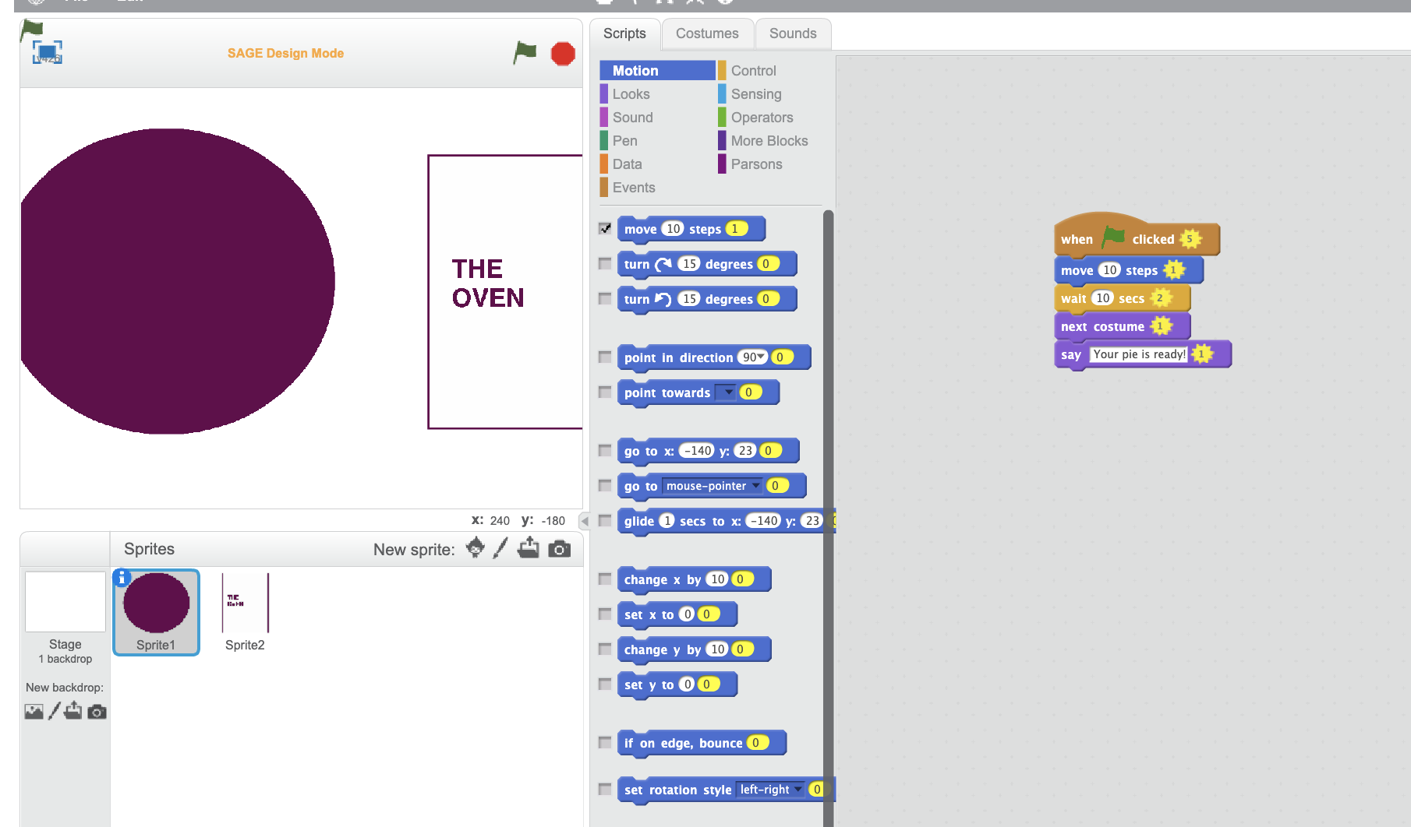
Puzzle Creation
Motivation
Related Work
Project Planning
Implementation
Demo
Future Work
Gameful
Building to loops
First iteration - without teacher input like a sketch
Notes:
First iteration - incorporate feedback, put in images

Slide 14
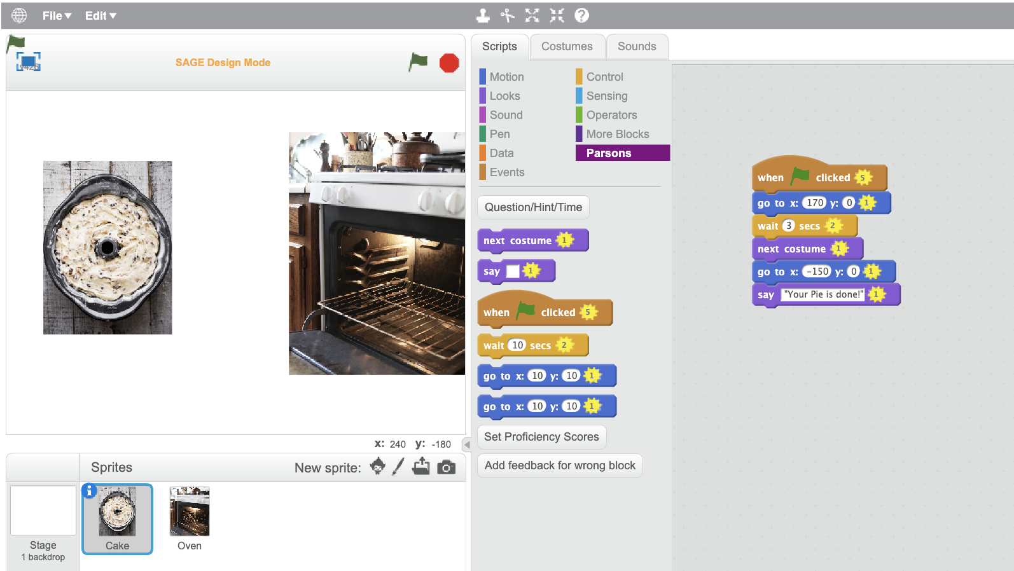
Puzzle Creation
Motivation
Related Work
Project Planning
Implementation
Demo
Future Work
Gameful
Building to loops
First iteration - without teacher input like a sketch
Incorporate teacher feedback & improve design

Slide 15
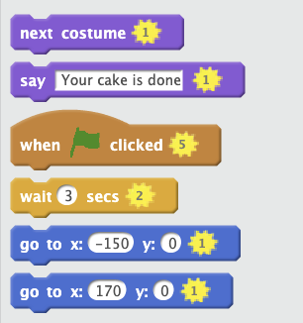
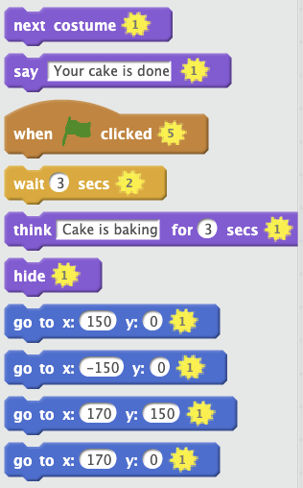
Distractors
Motivation
Related Work
Project Planning
Implementation
Demo
Future Work
Notes:
Use instruction sheet to enforced

Slide 16
Conversations with Teachers
Motivation
Related Work
Project Planning
Implementation
Demo
Future Work
Outline:
Intro Sage
Feedback on Puzzle Design (concepts, difficulty, distractors)
Feedback on tests/surveys (concepts, difficulty, comprehension)
Timing of study (order of events, expected time per activity)
In contact with 3 teachers from Upperline Connection
2 agree to host studies (1 in progress)

Slide 17
Demo
Motivation
Related Work
Project Planning
Implementation
Demo
Future Work
Demo the three conditions of the puzzles http://dev.cu-sage.org/#/
Qualtrics (Demo pre and post test) https://barnard.az1.qualtrics.com/Q/EditSection/Blocks?ContextSurveyID=SV_0xFhAjPYCKzvzCt

Slide 18
Future Studies
Motivation
Related Work
Project Planning
Implementation
Demo
Future Work
Gain feedback from Elissa → update protocols
Problems with flash
Long time to type in URL (another way of sending out)
Recruit more classrooms
Limitations of over 3 days → not all students come every day (unaccounted fluctuation)

Slide 19
Thank you!
Questions?

